Slide 1
ENSE 400 Bi-Weekly Scrum Report-Out
URStreamSight
Avery Cameron, Raymond Knorr, Noah Rowbotham
November 30, 2020

Slide 2
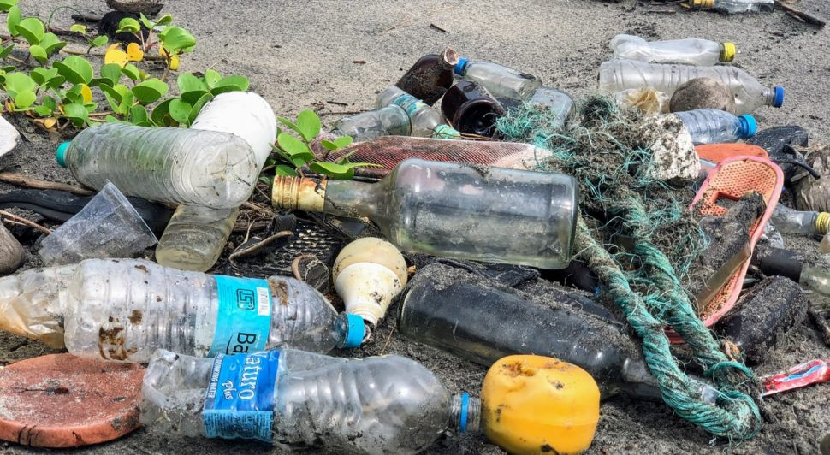
Project deats
Problem:
Citizens across Canada are confused regarding what proper recycling is.
Gap we are filling:
Giving data to municipalities to allow them to track/correct problem at its source. We are not actually sorting any recycling.
Innovation we are introducing:
Web application for municipality workers that scores recycling on a neighborhood basis and displays the data.

Slide 3
Project & Documentation review
What are you currently working on?
Front-end web-app development
CI/CD Pipeline for linting front-end app
Initial API Definition
InProgress/Future work
Creation of API
CI/CD Pipeline Development
“Show me what you got” (including but not limited to…)
CI/CD Pipeline
API Endpoint Definition
First Front-End MVP
GitHub/Version control “stamp of approval”
Is it readable, usable, “goodness” confirmed
Notes:
What are we currently working on:
Developing a front-end that displays amalgamated data to a user using TypeScript, and React
Work on endpoint definition and initial development of API using express and TypeScript
Integration of style-guides and linting to our CI/CD pipeline
Links for everything are on Github

Slide 4
API Endpoint Definitions | Front End | Pipeline

Slide 5
Group reflection
Do you feel you are on track?
We feel that we are on track. Getting started on the codebase feels a lot better. Initial CI/CD pipeline also feels good
Do you feel there are barriers to your success (if any)?
No real ones. Machine Learning portion of our project is large and will require a lot of work still
Do you need any help going forward?
Just more discussions with mentors about project scope and documentation
Any other questions or concerns?
What do you think of the idea of integrating our code into a mono-repo belonging to Prairie Robotics for code-reuse
How to share private repos with Tim and SSE faculty. Collaborators?

Slide 6
Image Refs
https://cleanriver.com/how-to-reduce-recycling-contamination/

